Slide 1
Research Methodology- Unit 2 Chapter 1- Research Problem
Prime College- BIM 6th Semester

Slide 2
Research Methodology
Background of the study
Problem Statement
Research Gap
Linkage of research problem with research objective, question and hypothesis
Assoc. Prof Dr Jugindar Singh

Slide 3
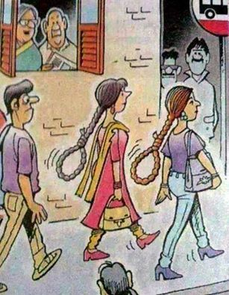
Proceed to write Chapter 1
Defining the Problem
Statement is the most
important part of your research

Slide 4


Learning Outcomes
Develop Background information
Establish the research problem
Develop research questions/objectives/hypothesis
Explain How to write research significance, scope, limitations and definition of terms
Milestone 1: Student should be able to identify research topic

Slide 5
TABLE OF CONTENTS
TITLE PAGE
TABLE OF CONTENTS
LIST OF TABLES
LIST OF FIGURES
LIST OF ABBREVIATIONS
CHAPTER 1 INTRODUCTION
1.1 Background to the Study
1.2 Problem Statement
1.3Objectives of the Study
1.4 Research Questions
1.5 Research Hypotheses
1.6 Significance of the Study
1.7 Scope of the Study
1.8 Limitations
1.9 Definitions of Terms
CHAPTER 2 REVIEW OF LITERATURE
2.1 Previous Studies Dependant Variable (Concept)
2.2 Previous studies Independent Variables(Concept)
2.2.1 Independent Variable 1
2.2.2 Independent Variable 2
2.3 Relationship between Ind. Variable 1 and DV
2.4 Relationship between Ind. Variable 2 and DVe
2.5 Theory (ies) and Theoretical grounding
2.6 Research Framework
2.7 Summary
TABLE OF CONTENTS
CHAPTER 3 METHODOLOGY
3.1 Introduction/Research design
3.2 Research Philosophy
3.3 Research Approach
3.4 Research Strategy
3.5 Research Choices
3.6 Time Horizon
3.7 Data type (Primary or Secondary)
3.8 Instrumentation/ Questionnaire
3.9 Sampling technique and sample size
3.10 Data collection
3.11 Data processing
3.12 Data Analysis
3.13 Ethical Consideration
References
Appendices
CHAPTER 1

Slide 6
Chapter 1: Introduction
CHAPTER 1 INTRODUCTION
1.1 Background to the Study
1.2 Problem Statement
1.3 Objectives of the Study
1.4 Research Questions
1.5 Research Hypotheses
1.6 Significance of the Study
1.7 Scope of the Study
1.8 Limitations
1.9 Definitions of Terms
This chapter explains the background of the study, statement of the problem, research questions, and objectives of the study, significance of the study, definitions used in the study, limitations of the study, and the operational definitions of the thesis.

Slide 7
Learning Outcome 1
Develop Background information
Milestone 1: Student should be able to identify research topic

Slide 8

How to write a background of your study?

Slide 9
1.1 Background
The Topic proposed to be studied is introduced in this section.
It should help the reader to acquaint with the topic
Start with general scenario
Go to a more specific scenario
What is your research area,
The background of your study will provide context to the information discussed throughout the research paper
Adoption of e-wallet by Gen Z in Malaysia. A quantitative study
First Impression. Need to create Curiosity. Scenario.
Broad overview of the subject matter or the phenomena of interest provided
Set the current scenario (Scenario setting)?
Provided latest statistics or data to support the argument

Slide 10
1.1 Background
Example
Barriers towards Leadership positions: A qualitative study among women in the Malaysian Private Sector
Broad overview of the subject
Phenomena of Interest - POI
Introduction to subject matter and phenomena of interest you intend to study
Describe the broad foundations of your study— the readers understand what you intend to study
Start with a
good Scenario
G: Global
L: Local (Malaysia)
C: Context (Sector/Industry)
Sets the stage for the entire study, providing the reader with the background information for placing the study into a context of related research and justifying to the reader that a study is needed (Wiersma, 1995).

Slide 11
Learning Outcome 2
Establish the research problem
Milestone 1: Student should be able to identify research topic

Slide 12

RESEARCH TOPIC
1.1 Background
1.2 Problem Statement
1.3 Objectives
1.4 Research Questions
1.5 Research Hypothesis
1.6 Significance
1.7 Scope
1.8 Limitations
1.9 Definition of Terms

Slide 13
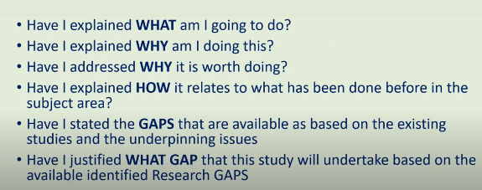
What is a Problem?
Masaalah
A research problem is an educational issue or concern that an investigator presents and justifies in a research study Cresswell, 2002
A research problem is an issue that attracts attention of OR motivates a researcher to conduct a study on it
(Source: Piaw, C.Y. 2016)
Questions to ponder

Slide 14

A research starts with a
Problem Statement
What is the issue or controversy that attracts attention
What is the justification of doing this study
What was ‘MISSING” GAP”
What is the “Deficiency” in Literature
Why is this problem important?”
What is the contribution
Question
Example 1
Explore the Motivation of Millennials to work in Gig Economy. Evidence from Malaysia
Example 2
The barriers towards leadership role of Women: A Qualitative study in Brunei

Slide 15
Problem Identification – Bryman, 2007
A research problem is a definite or clear expression [statement] about
an area of concern,
a condition to be improved upon,
a difficulty to be eliminated,
or a troubling question that exists in scholarly literature, in theory, or within existing practice
that points to a need for meaningful understanding and deliberate investigation (Bryman, 2007)
A problem area is an area of interest to the researcher where some aspect(s) is (are) still to be studied to find a complete or even a partial solution to an existing or an anticipated unanswered question.
Purpose Statement
Objective
Research Questions
Bryman, Alan. “The Research Question in Social Research: What is its Role?” International Journal of Social Research Methodology 10 (2007): 5-20; Guba, Egon G., and Yvonna S. Lincoln. “Competing Paradigms in Qualitative Research.” In Handbook of Qualitative Research. Norman K. Denzin and Yvonna S. Lincoln, editors. (Thousand Oaks, CA: Sage, 1994), pp. 105-117.

Slide 16
Research Problem – Piaw, 2016
A research problem is an issue that attracts attention of OR motivates a researcher to conduct a study on it
(Source: Piaw, C.Y. 2016)
Eg: To study the cause of escalating violence in schools
The barriers towards leadership role of Women: A Qualitative study in Brunei
Exposing the Gap
Your current study must clearly explain what other studies have not examined
Explain the importance of a study or to justify it.

Slide 17
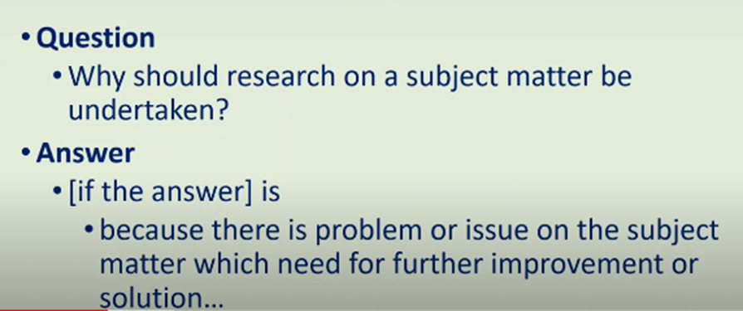
Definition
Eg: To study the cause of escalating violence in schools
(there is an issue that needs a solution)

Slide 18
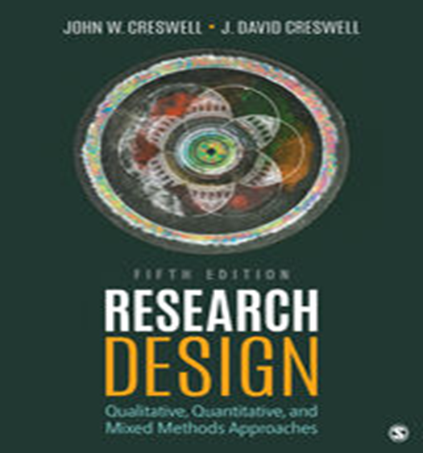
Problem Identification? - Creswell
Example: Escalating violence in schools
Start by posing several questions and then writing down short answers to them.
◆ “What is the specific controversy or issue that I need to address?” Escalating violence in the schools
◆ “Why is this problem important?” Schools need to reduce the violence; students will learn better if violence is less a part of their lives, etc.
◆ “How will my study add to what we already know about this problem?” We really don’t have many school plans for addressing this escalating violence
◆ “Who will benefit from what I learn about this problem?” Schools, anybody interested in learning how schools can respond to escalating violence (the body of literature, administrators, teachers, etc.)

Slide 19
Problem Identification Is a Research Problem? - Creswell
A research problem is an educational issue or concern that an investigator presents and justifies in a research study Cresswell, 2002
To locate the research problem in a study, ask yourself:
◆ What was the issue, problem, or controversy that
the researcher wanted to address?
◆ What controversy leads to a need for this study?
◆ What was the concern being addressed “behind”
this study?
◆ Is there a sentence like “The problem addressed in this study is..?

Slide 20
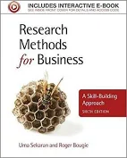
Problem Identification Sekaran & Bougie (2016)
A problem as any situation where a gap exists between an actual and a desired ideal state - Sekaran & Bougie (2016)
A “problem” does not necessarily mean that something is seriously wrong with a current situation that needs to be rectified immediately. A problem could also indicate an interest in an issue where finding the right answers might help to improve an existing situation

Slide 21
Example: Barriers to career advancement of millennium females in Bangladesh
Justification on the need to do this study
What is the problem or issue on this subject the need improvement/solution
What is the ‘gap”
Example of a proper, specific, evidence-based, real-life dissertation research problem:
“Only 6% of CEOs in Fortune 500 companies are women” (Center for Leadership Studies, 2019).
Women in the RMG sector in Bangladesh are struggling to get better positions
Most women are in low paid production section (97.1%).
There are more men than women in higher level positions (ILO, 2020)
Only 9.1% in Managerial positions (ILO, 2020).

Slide 22

More Examples
Staff turnover is higher than anticipated.
Long and frequent delays lead to much frustration among airline passengers. These feelings may eventually lead to switching behavior, negative word‐of‐mouth communication, and customer complaints
The current instrument for the assessment of potential employees for management positions is imperfect.
Minority group members in organizations are not advancing in their careers.
The newly installed information system is not being used by the managers for whom it was primarily designed.
The introduction of flexible work hours has created more problems than it has solved.
Young workers in the organization show low levels of commitment to the organization.
Sekaran and Bougie
These problems also have in common is that they still have to be transformed into a researchable topic for investigation.
Once we have identified the management problem, it needs to be narrowed down to a researchable topic for study

Slide 23

How to write the Problem statement?

Slide 24
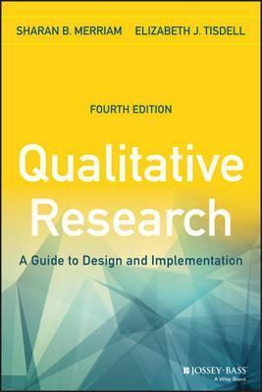
Problem Statement. Context, Gap, Significance
1. Context
Inconsistency of Findings in the area
Relatively little OR dearth of empirical research
No attempt to relate the possible factors
Previous studies focused on other industries
Lack of tools
Difficulties due to unknown factors
Lack of understanding. Eg interview to find out..
2. Gap
3. Significance.

Slide 25
Problem Statement
Model by Merriam, S. and Tisdell (2015)
1. Context
What is the area or topic you are interested in and about which you have a particular question? What is wrong with the current situation
2. Gap
The identification of the gap in the knowledge base—what we don’t know that your research will address. What researchers have not discovered..
3. Significance
How big is the problem, why it is important to fill the gap, consequence ….
Purpose
The purpose statement is followed by three research questions.

Slide 26
Three important components to the problem statement.
Context
What is the current situation?
What is wrong with the current situation? What led to the current situation?
Eg: Technostress among female employees working remotely
Career advancement of millennium females in the IT sector in South Africa
What the current situation is and what is wrong.

Slide 27
2. The knowledge gap
A second component is the identification of the gap in the knowledge base—what we don’t know that your research will address.
What have researchers in similar settings discovered?
What have researchers in other settings discovered?
What remain unknown about the problem?
“While ……………….is known ……………..remain unknown”
Perhaps nothing in the literature addresses your question, or there may be some research but, for reasons you make clear, it is inadequate or flawed in some important way.
Lead the reader to the point that where the necessity for the study is obvious
Eg: Point out the lack of research related to the exact topic, and then problem statements often conclude with the statement, “The purpose of this study is to . . …………
Eg: Despite the fact that there is much discussion on embodied learning in the literature, there is a paucity of data-based published research studies on how people actually learn through the body. "The purpose of this study

Slide 28
3. Significance
Implicitly or explicitly, that this is a significant problem to address.
1. Why is it important to fill in the knowledge gap?
2. How big is the problem. How many people are affected?
3. Consequences. What are the consequences of not addressing this problem?
Contribution. How will your study contribute to the problems solution?
How does filling the gap help?
The third component is making it clear, either implicitly or explicitly, that this is a significant problem to address.
There is some urgency about addressing this problem.
The problem statement ends with the purpose statement and research questions.

Slide 29
PROBLEM STATEMENT: ENGAGING MOMENTS: ADULT EDUCATORS READING AND RESPONDING TO EMOTION IN THE CLASSROOM. An exploratory study.
Context
Research in neuroscience indicates that emotional states are the starting point for all learning (Damasio, 1994a,1999, 2003; LeDoux, 1996, 1999, 2002). There are thousands of states, each containing a unique mix of potential behaviors, feelings, and 16 emotions that can either enhance or impede learning. ……
Gap
The literature in the fields of adult education and learning readily acknowledges that emotions influence the learning process (Argyris, Putnam, & Smith, 1985; Dirkx, 2001; Heron, 1999; Lovell, 1980; MacKeracher, 2004; Merriam et al., 2007; More, 1974)……. However, there is surprisingly little research and/or literature on how this process plays out in the adult classroom. This study sought to have in-depth understanding and thick description of the nature of the experiences of a group of adult educators and how they go about reading and responding to learners’ emotional states in practice.
Significance
This study was undertaken to provide an in-depth portrait of emotions in the adult classroom through the eyes of adult educators who work in formal learning environments. The solution to this problem will result in better understanding of the emotional states …….
Purpose Statement and Research Questions
The purpose of this study was to better understand the practices of adult educators in reading and responding to emotional states exhibited by learners. The study was guided by the following questions:
1. What indicators do adult educators use to read and determine emotional states?
2. What actions do adult educators take in response to learners’ emotional states?
3. What is the reasoning behind the actions taken?

Slide 30
Exercise
Parents Raising Children with Disabilities: An exploratory study among parents of disabled children in Kuala Lumpur
Write the Problem Statement

Slide 31

Putting It Together: Title, Problem Statements, Purpose Statements, and Research Questions

Slide 32
Title: E.g.: Examining the influence of IOT and Cloud computing towards managers performance in the Maritime industry in Malaysia
Normal Research
Small scale
Short Term
Your Research
Contribution 1. Theory
2. Model (formula, framework)
High Impact Research
Large Scale/Long Term Gap – in knowledge
Title Reflecting Main Objective
Objective
Main Objective Specific Objectives
Main Objective
The aim of this study is to examine the effect of IOT and Cloud computing towards managers performance in the Maritime industry in Malaysia
Specific Objective
To examine the relationship bet. IOT and managers performance
To examine the relationship bet. Cloud Computing and managers performance

Slide 33
Putting It Together: Title, Problem Statements, Purpose Statements, and Research Questions
Barriers towards leadership Roles
Example
A research topic is the broad subject matter being addressed in a study.
A research problem is an educational issue or problem that justify a study
A purpose is the major intent or objective of the study.
Research questions are questions the researcher would like answered or addressed in the study.
General
Topic
Barriers faced by women in
career advancement
Research
Problem
Low number of women in leadership positions
Purpose
Statement
To study barriers faced by women in career advancement in Brunei
Specific
Research
Question
Does Glass ceiling effect, fat cat syndrome ad queen bee syndrome affect the career development of women?

Slide 34
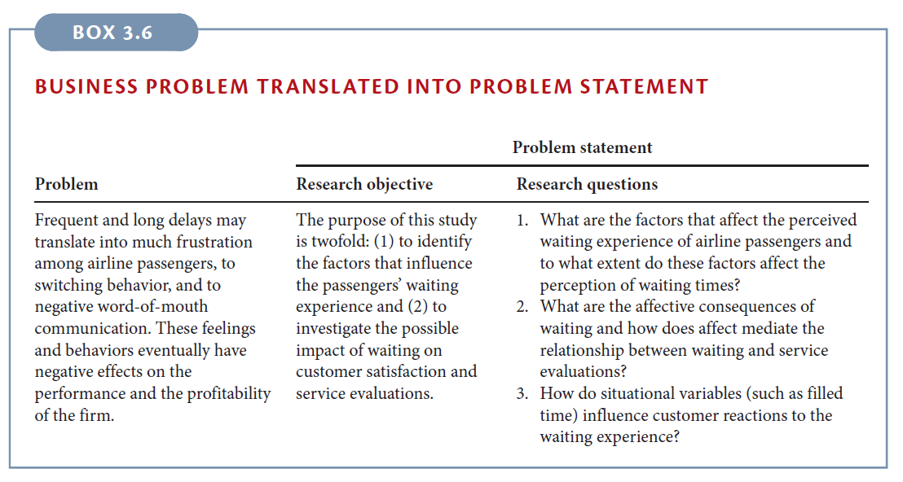
Recap: Problem statement is aligned to Research Objective and Research Questions

Slide 35
End of Chapter 1
Find out more at the PowerPoint Getting Started Center
(Click the arrow when in Slide Show mode)
Notes:
In Slide Show mode, click the arrow to enter the PowerPoint Getting Started Center.

